Slide 1
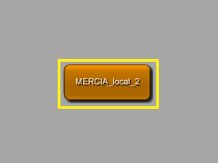
How to use MERCIA
Install MeVisLab
https://www.mevislab.de/download/
Version 2.7 or newer
Ask Sylvia for license ☺
Go to folder [S:\\] Tools\MERCIA and copy folder „v2“ to your computer or unzip „v2.zip“ into an arbitrary folder
Go to folder and open START_MERCIA_LOCAL_2.mlab by doubleclicking it
Double click on MERCIA module in MeVisLab to open GUI

Slide 2
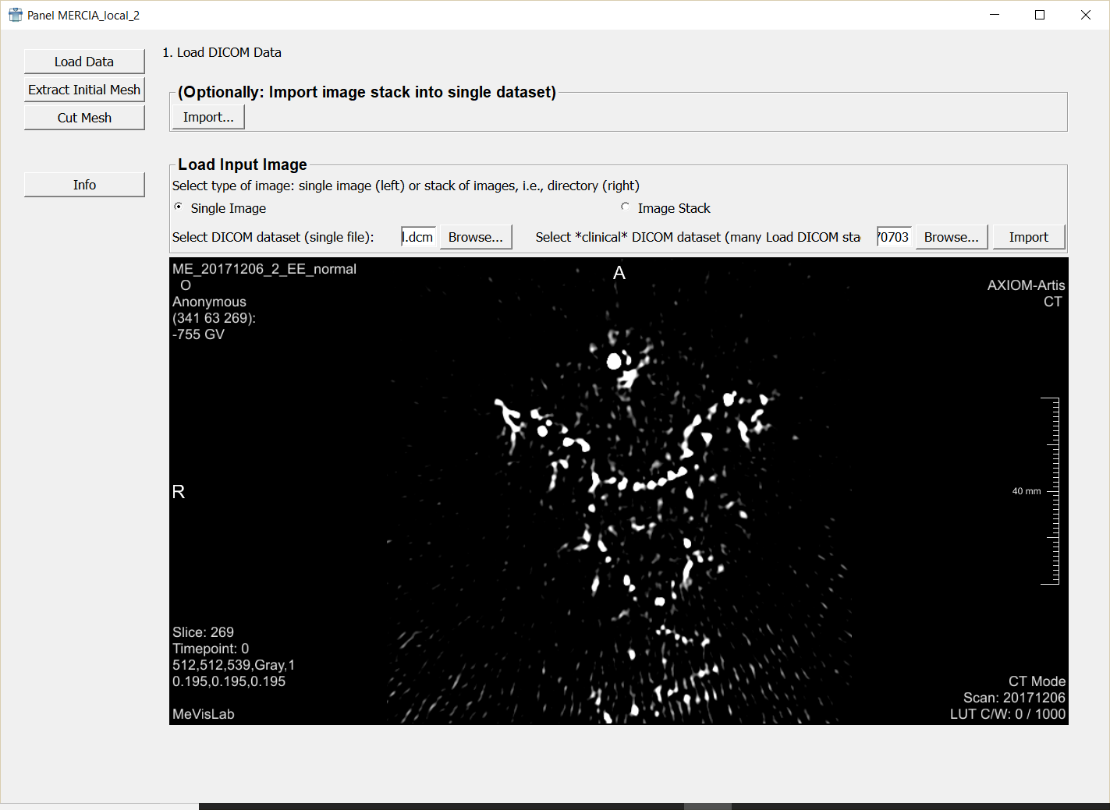
The first screen is the Load Data Screen, it‘s automatically opened

Slide 3
1
2
Normal case: Select the single dicom file (select checkbox (1) and click „Browse“-Button (2) )
-> next, you should see the 2D slice view (3) of the dataset
3
Hint: Change viewing parameters of 2D view by pressing down RMB and moving mouse

Slide 4
Click on extract initial mesh to proceed

Slide 5
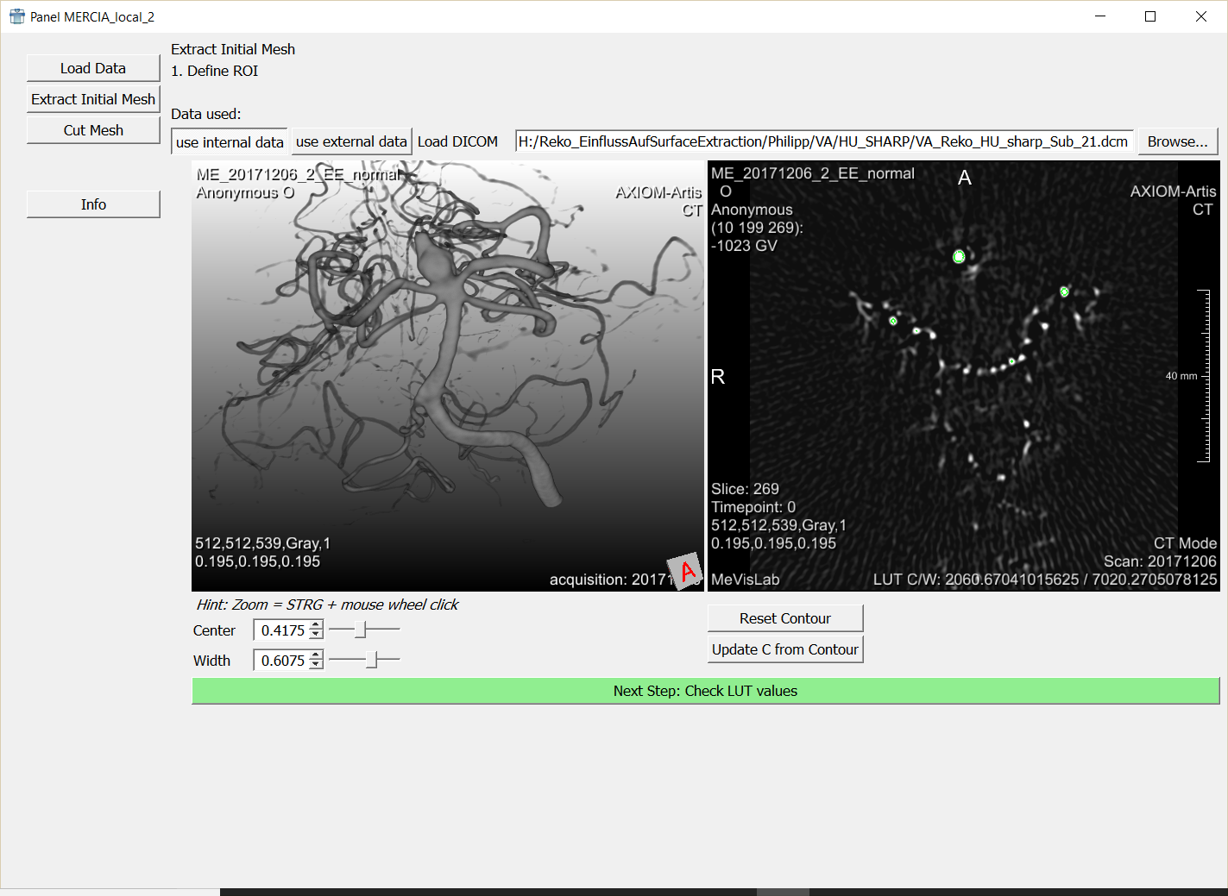
2
Most Users: have a look at the data and click
„Next Step: Check LUT values“ (3)
Advanced Users: you can change windowing parameters to adapt threshold parameters (1) and (2) and see their 2D and 3D counterpart
1
3

Slide 6
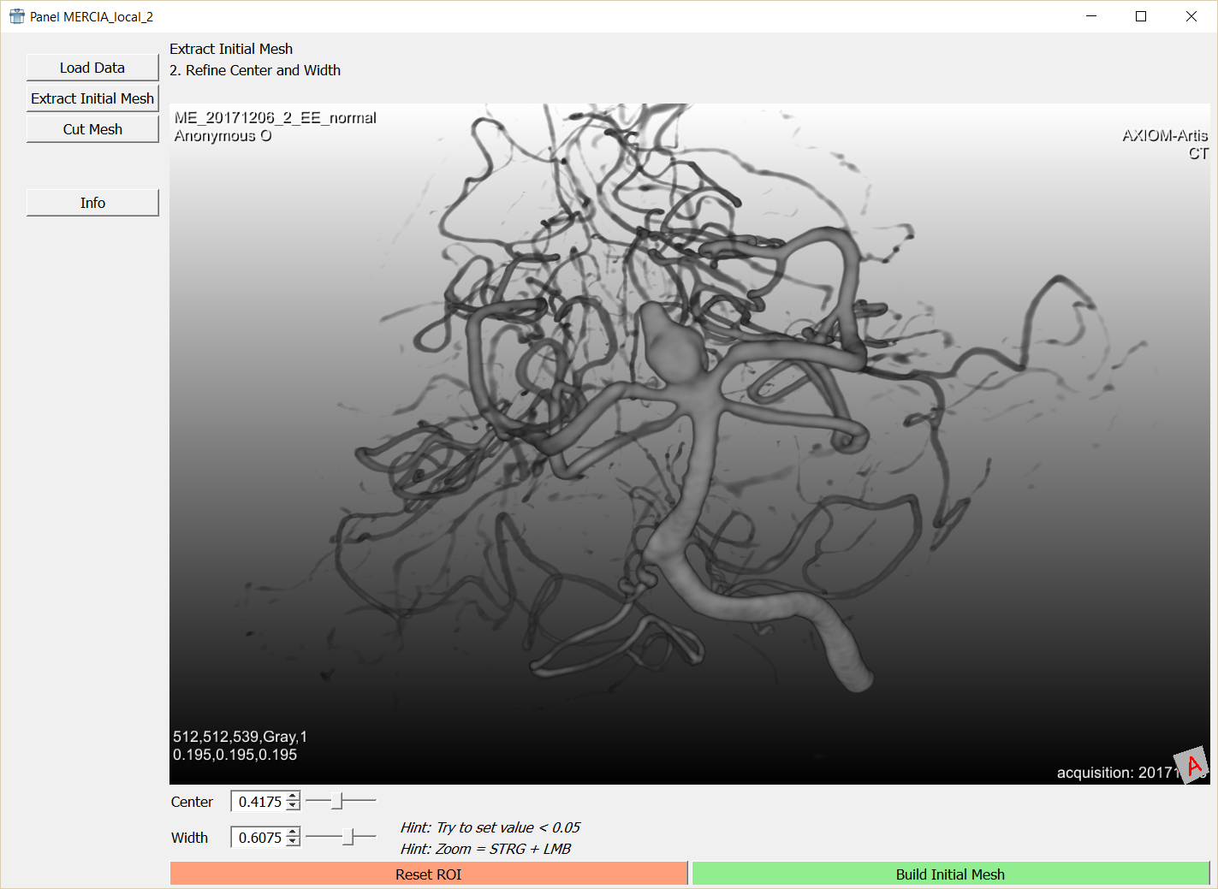
Next: please carefully adapt the parameters by clicking and holding right mouse button
- Up and down -> change center
Left and right -> change width
Strg/ctrl + pressed mouse wheel: zoom in and out
Shift + pressed mouse wheel: pan / translate

Slide 7
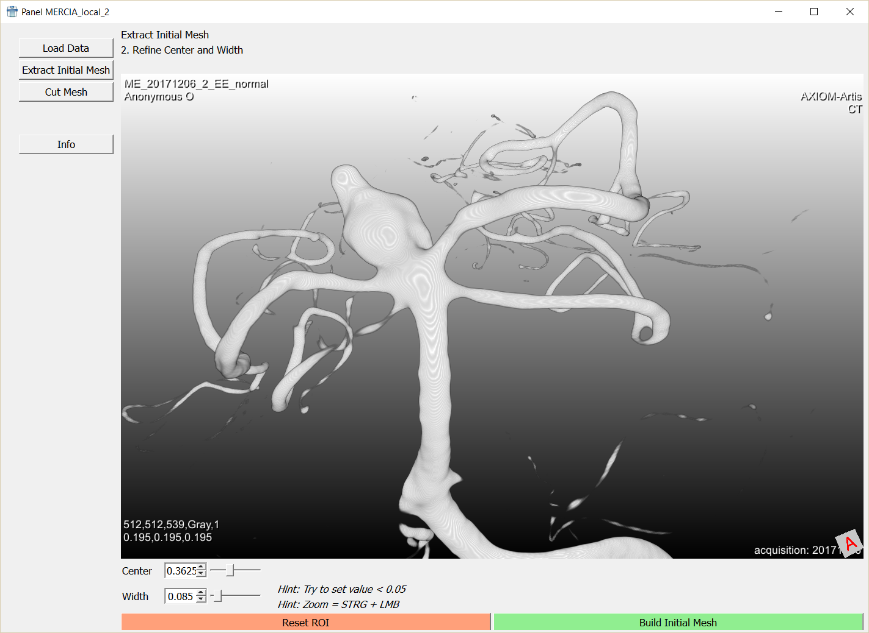
Hint: threshold is to high, small vessels (1) are not contained!
1

Slide 8
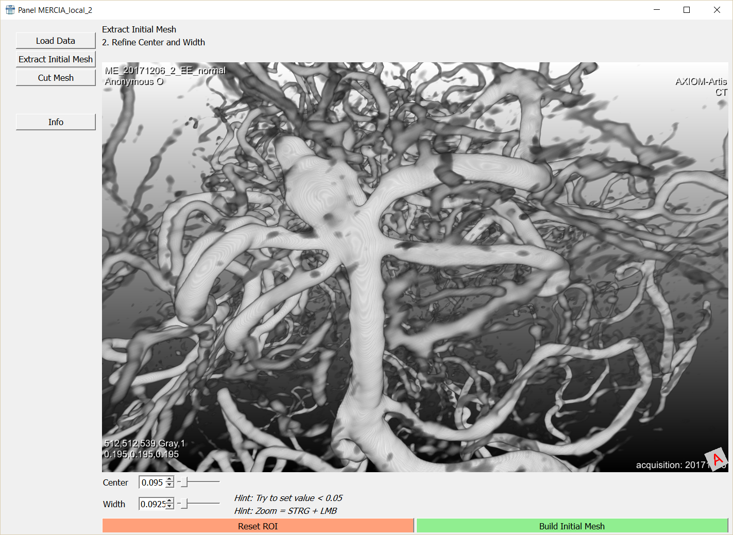
Hint: threshold is to low, noise and many small parts are contained

Slide 9
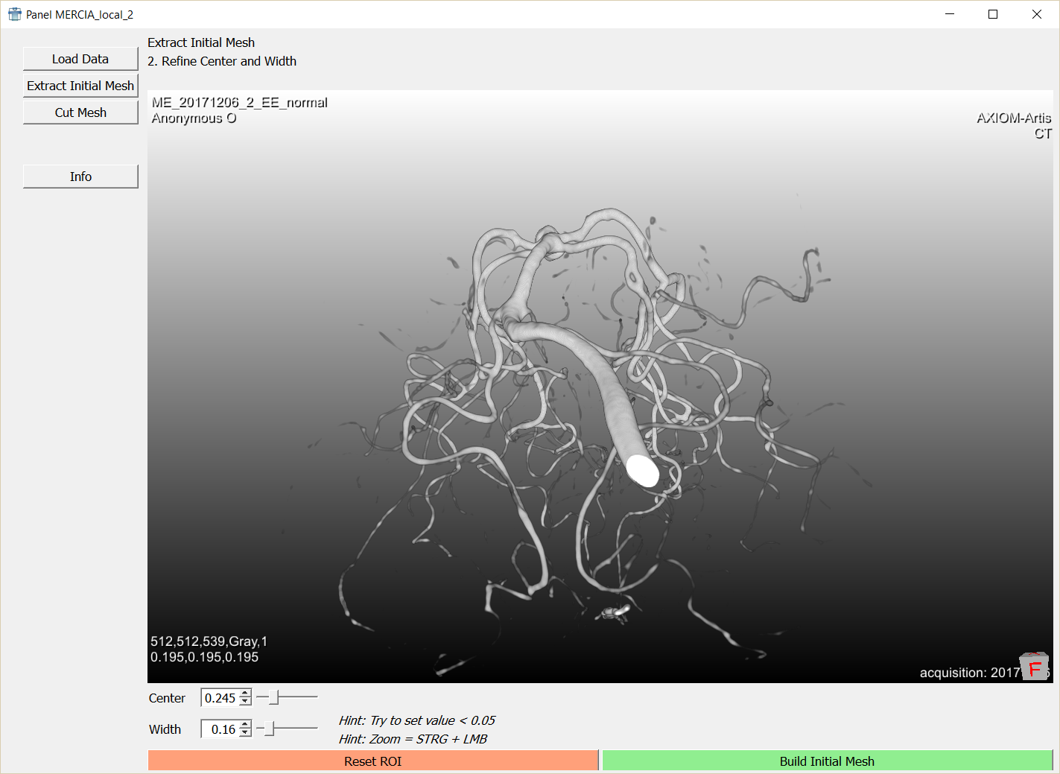
Hint: make also sure, the inlet is contained (1) without contrast enhancement artifacts
1

Slide 10
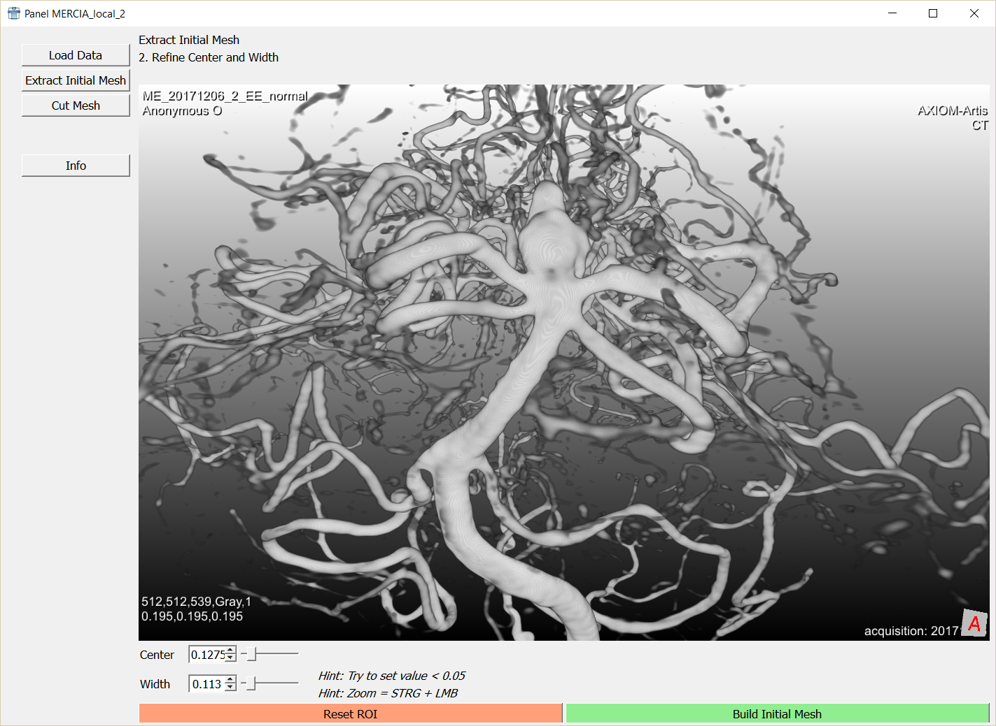
After you are satisfied, set parameter for width to 0.05 or smaller (1);
See result on next page
1

Slide 11
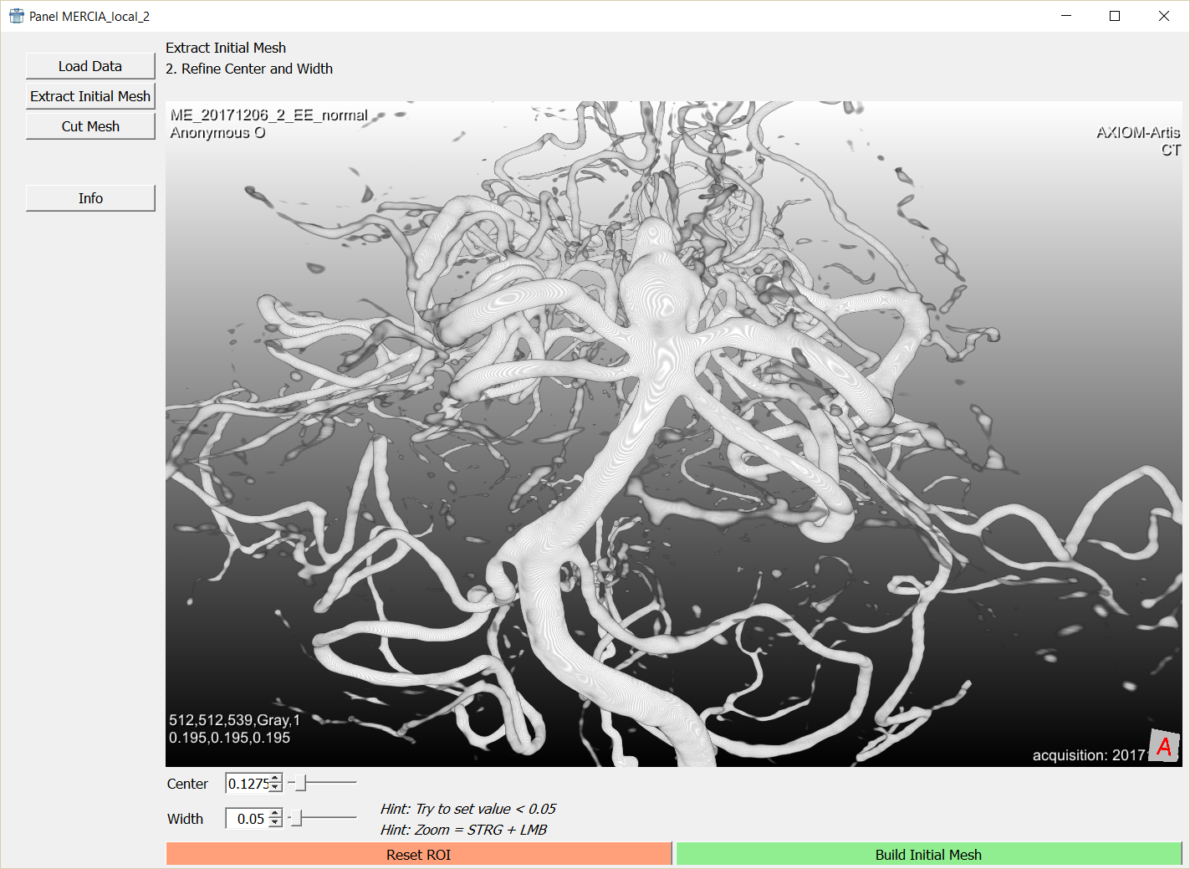
Select „Build Initial Mesh“ Button (1)
(mesh extraction may take a few seconds)
1

Slide 12
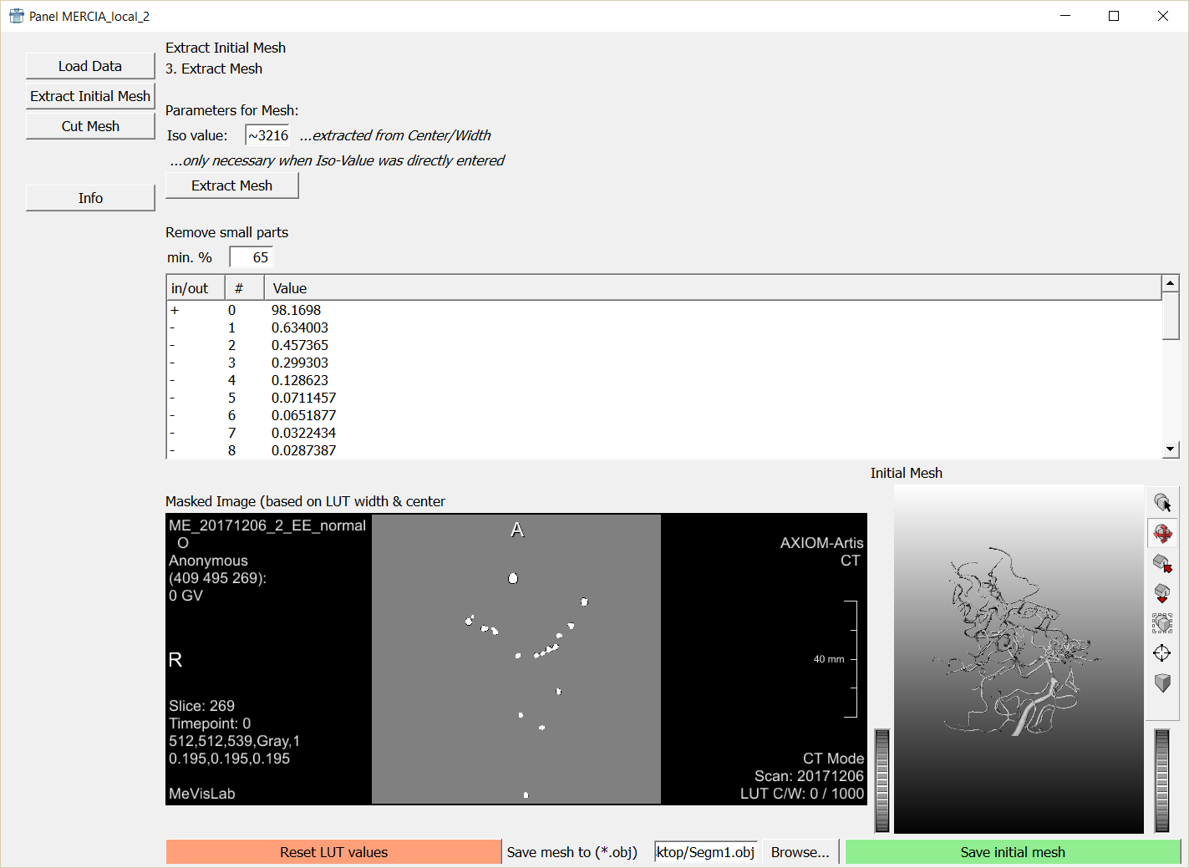
You‘ll see the result in the bottom right.

Slide 13
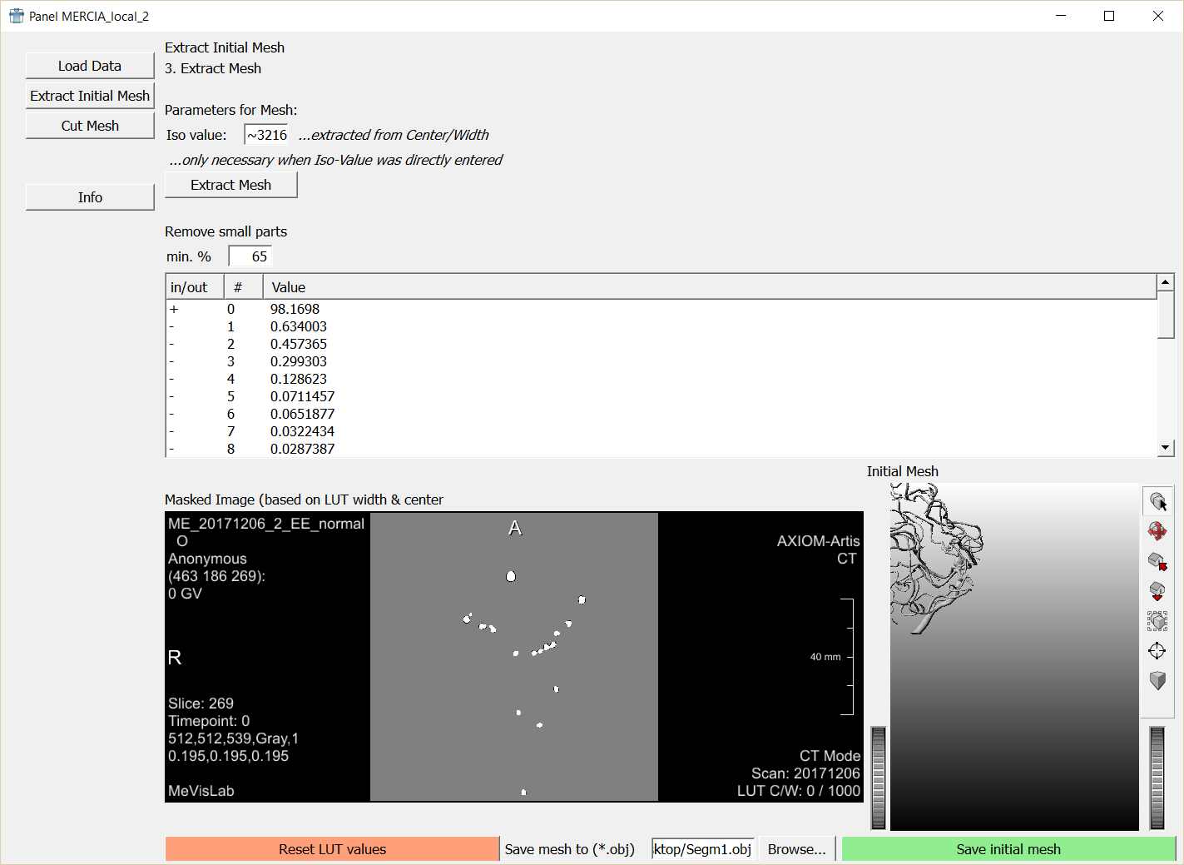
Sometimes the view is not centered, fix it by pressing „View All“ (1)
1
1

Slide 14
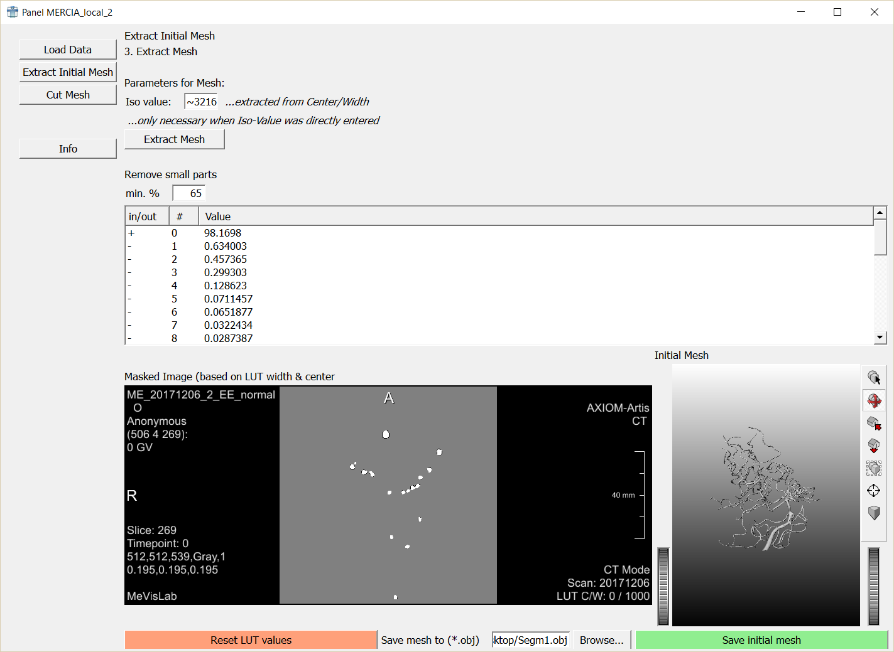
In the center, you can remove small parts of the mesh (like artifacts, see example on next slides)
Default value: just keep everything with at least 65% size of overall mesh

Slide 15
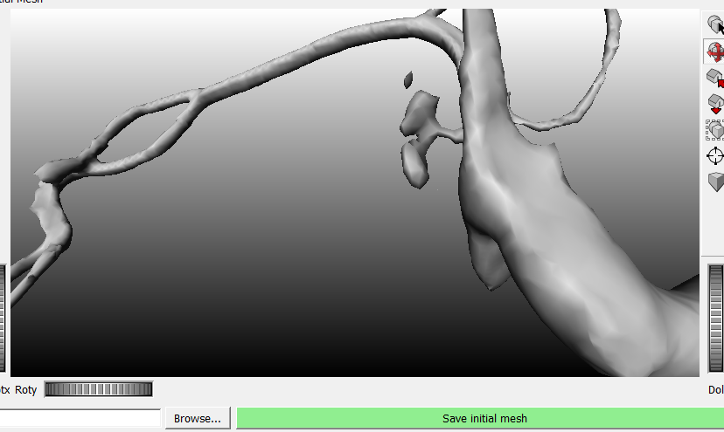
example of small artifact, you are automatically removed it by using default value of 65% for minimum size

Slide 16
Save the data by selecting a filename (click Browse (1))
Set your filename, e.g., “Student_Project_XXX_DSA.obj”
(make sure to add „.obj“)
Click „Save initial mesh“ (2)
1
2

Slide 17
Congratulation! You segmented your first mesh!

Slide 18
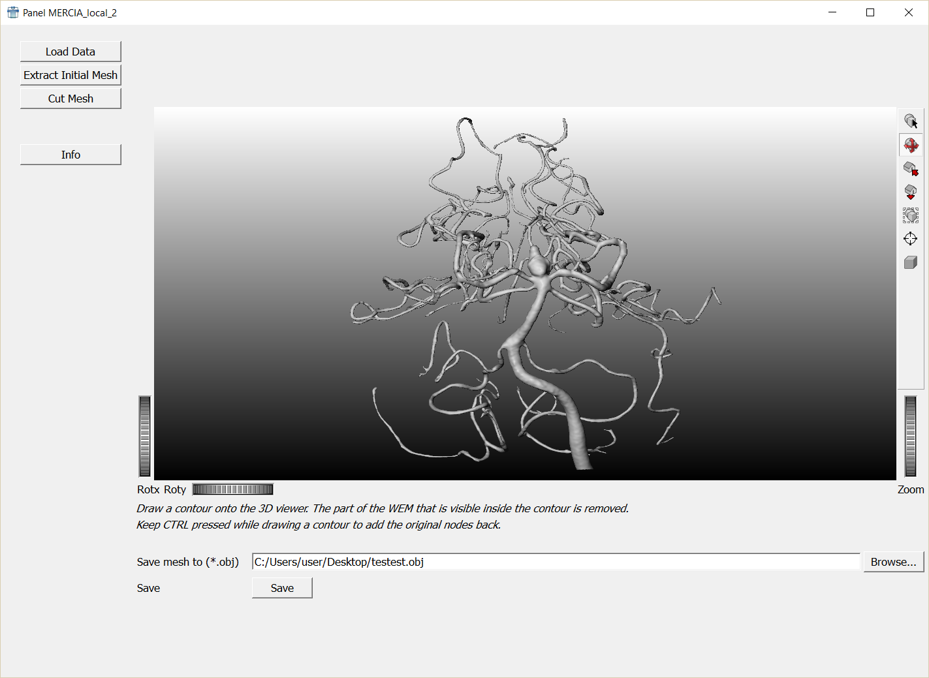
Next steps / advanced users:
After initial segmentation, you can also cut the mesh by selecting the „Cut Mesh“ Button

Slide 19
Hint: Navigation
Strg/ctrl + pressed mouse wheel: zoom in and out
Shift + pressed mouse wheel: pan / translate
Change between object and select mode via ESC
If you don‘t see your modell press „View All“ (1)
1

Slide 20
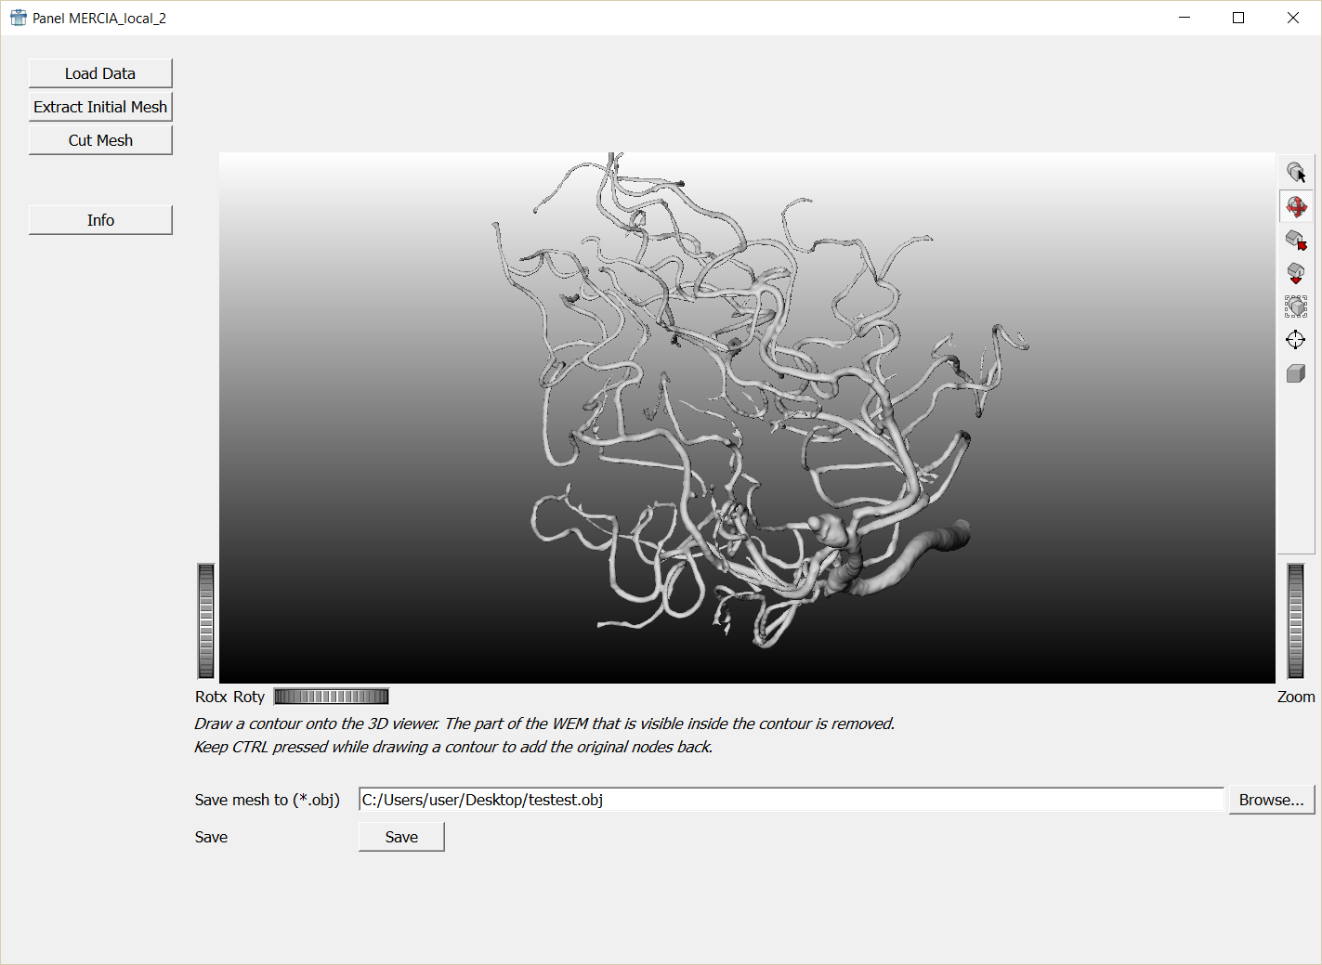
Draw a contour to remove parts of your mesh (press ESC to switch to this mode);
See result on next slide

Slide 21
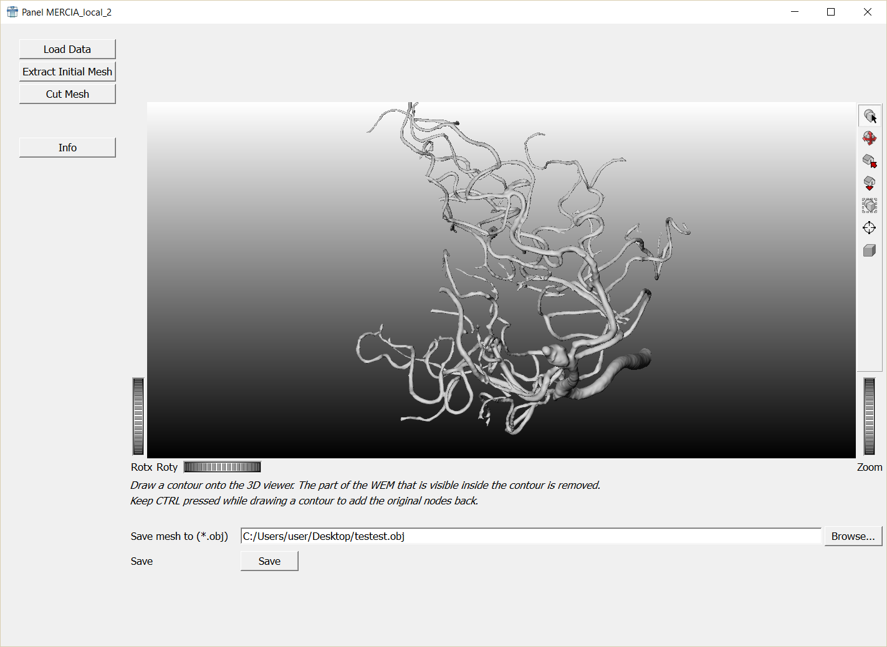
For advanced users: you‘ll have to close the cut surfaces with Blender or other programms later on if you want to create a nice model suitable for a simulation.

Slide 22
Save the data by selecting a filename (click Browse (1))
Set your filename, e.g., “Student_Project_XXX_DSA.obj”
(make sure to add „.obj“)
Click „Save initial mesh“ (2)
1
2

